Slide 1
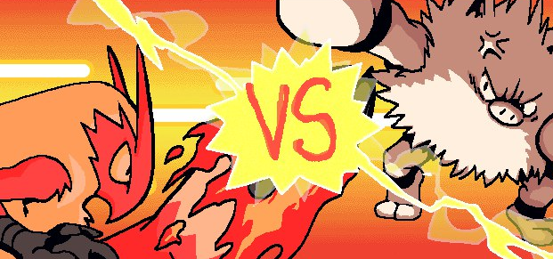
Training Mode Start! Training a Deep Learning Model for an AI-Controlled NPC
DSI-SG-41
Muhd Faaiz Khan

Slide 2
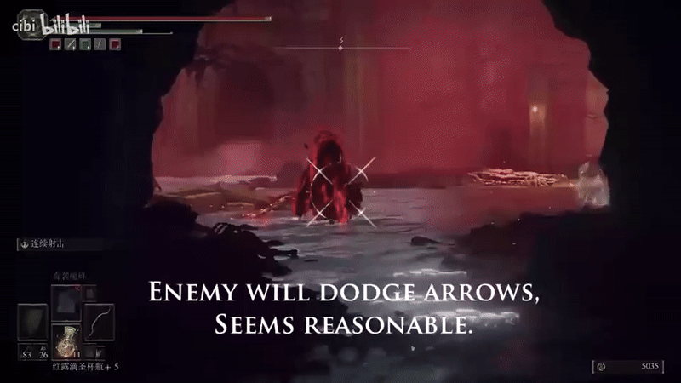
Enemy NPCs in Video Games
Enemies in video games are designed to challenge and engage the player, an optimal gaming experience is where a player regards enemies as plausible threats that can feasibly be overcome.
Enemy NPCs that are either too overwhelming or too easy will break the immersion for the player. Thus, there is a push for game developers to design ‘believable’ behavior in enemy NPCs.
GOAL: Using machine learning methods to train a non-player entity to behave in a believable and engaging way.

Slide 3
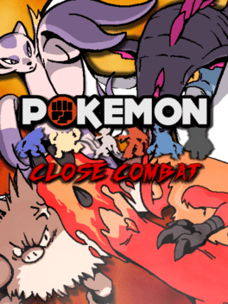
Game to be trained on
For this project, I will be training the model on Pokémon: Close Combat, a 2-D fighting game (like Street Fighter) made by Pokémon fans (free to download here!)

Slide 4




Model objectives
We will train a deep learning model to play through the first three stages of Close Combat’s arcade mode, using the default character Blaziken.
The model will be trained on human inputs to react to on-screen information.
Three separate models will be trained, one for each opponent.

Slide 5
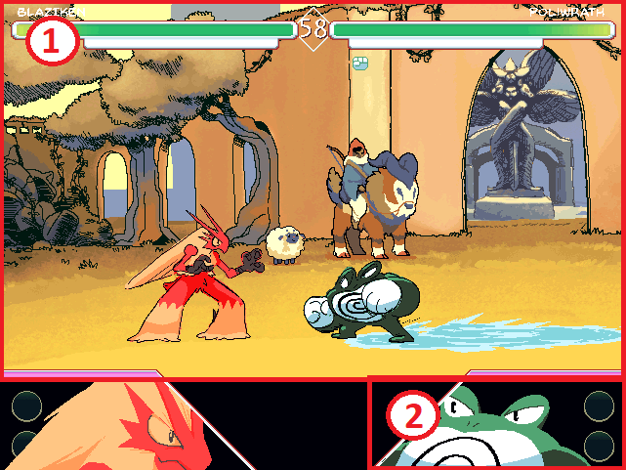
Data collection
Our data collection function uses the OpenCV Python library to capture these 2 images from an open game window.
Image 1 (Battle scene)
Image 2 (Enemy portrait)
When an enemy portrait is detected (using OpenCV’s template matching), the function starts saving the images to a folder. The corresponding input performed by the player during the screenshot is recorded using the keyboard library, and saved as a list of 7 booleans.
[1, 0, 0, 1, 0, 1, 0]

Slide 6
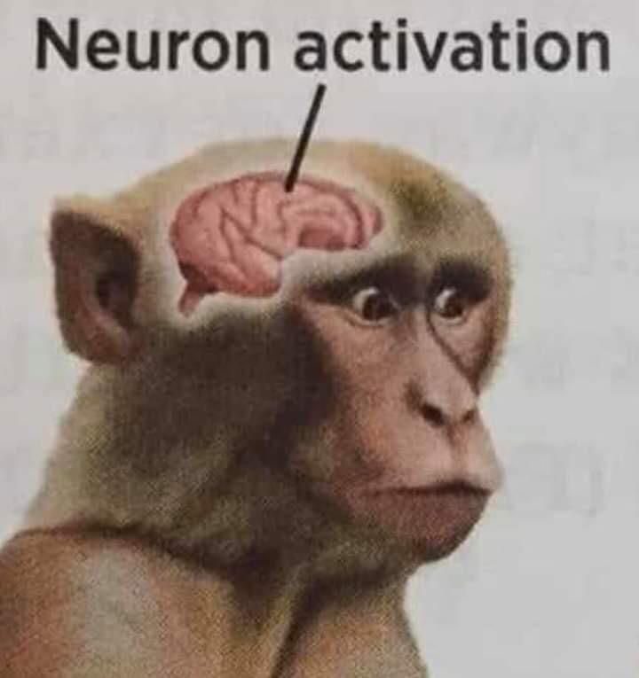
Bot script
Once the model is complete, it is deployed using a Python script. This script uses the same OpenCV classes to detect the battle scene and enemy portrait.
When a portrait is detected, read the screen to perform predictions using the model associated with the detected portrait.
Use the prediction output to perform corresponding key presses using the PyKey library.

Slide 7
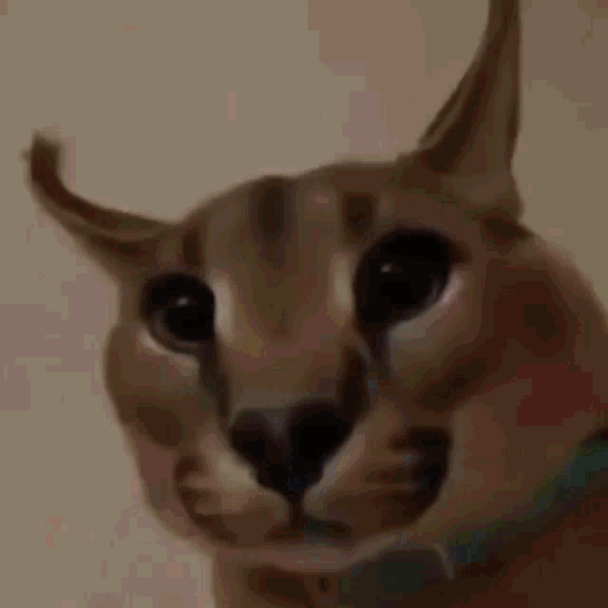
Model used: Convolutional Neural Network
CNNs are a type of supervised machine learning algorithm. The input (usually an image) is initially processed as a numerical array. The array is passed through convolutional layers, where multiple filters are applied to identify spatial/temporal patterns within the image. After passing through these convolutional layers, the output is flattened into 1-D and passed through dense layers, finally producing the output.
Often used for image classification and object detection, but have also been used to train models to play board games (such as Go).

Slide 8
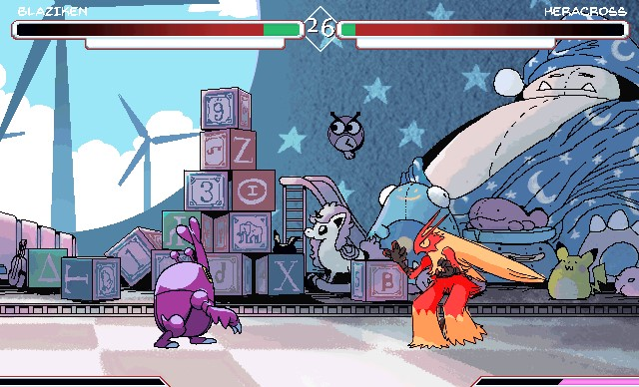
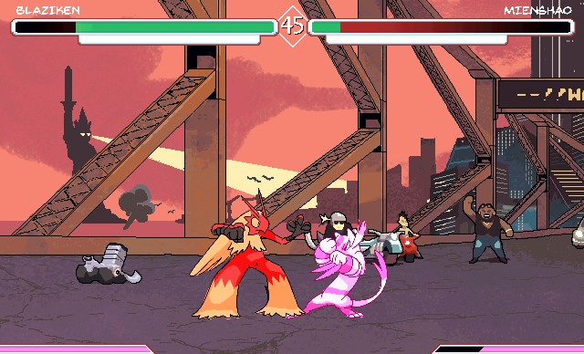
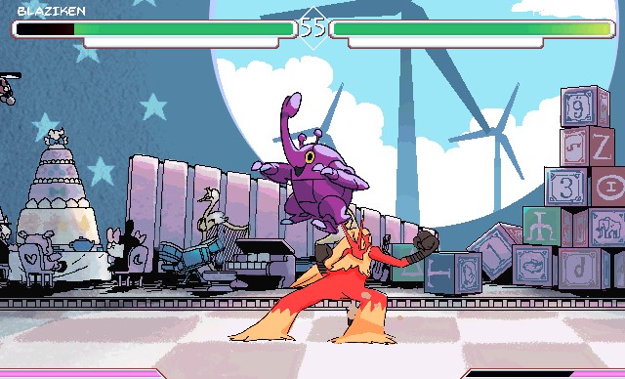
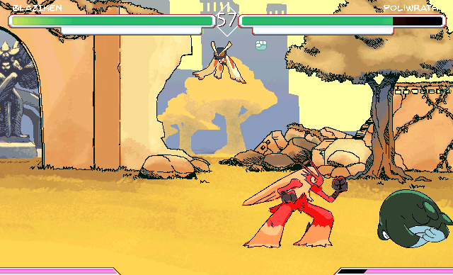
CNNs for fighting games
In fighting games, a player’s actions are largely dependent on the current state of the battle scene; the player is expected to make quick, split second decisions based on immediate and current information.

Slide 9
CNNs for fighting games
A CNN is thus an appropriate model for a fighting game, as the model will be able to make these split-second decisions based on immediate on-screen information, using trained data.

Slide 10
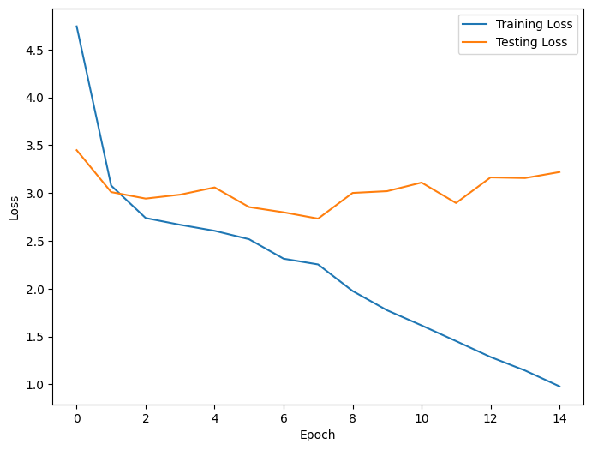
Initial Model Performance
vs Poliwrath
Training loss | 0.9787
Validation loss | 3.07

Slide 11
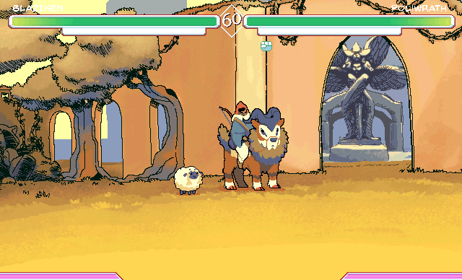
Initial Model Performance

Slide 12
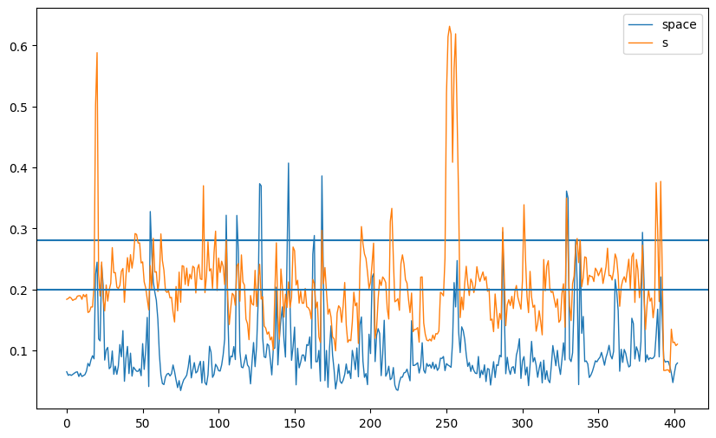
Bot Refinement: Defining Thresholds
The stochastic nature of deep learning models results in varying prediction values between different models.
To determine the appropriate threshold at which to perform inputs, we first monitor the predictions made by the model over the course of a round, and adapt our thresholds accordingly.

Slide 13
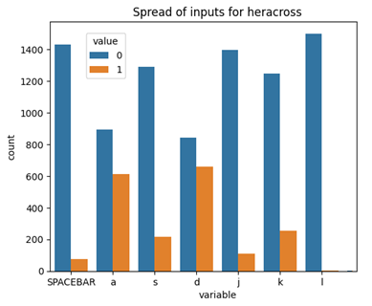
Data Refinement: Feature Engineering
Even after adjusting thresholds, the model had very low predictive values for the three attack inputs ‘j’, ‘k’ and ‘l’. To improve the frequency of attack detection, we engineer a new feature ‘isattack’, a boolean value that is True for any row where at least 1 attack input is present.

Slide 14
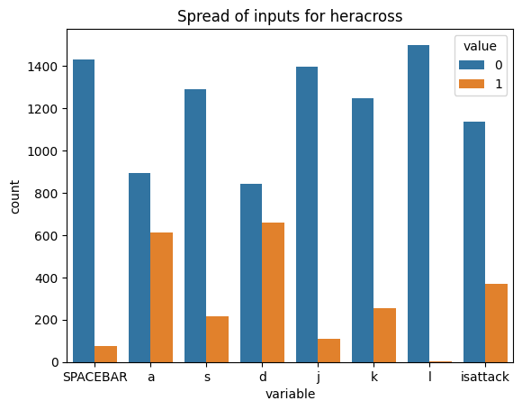
Data Refinement: Bootstrapping
Certain inputs are underrepresented in the data and are thus poorly predicted by the model.
We bootstrap such inputs to improve the model’s confidence in predicting these inputs.

Slide 15
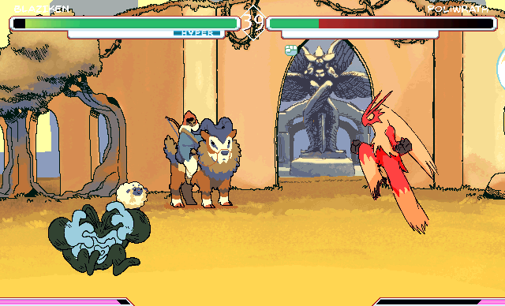
Data Refinement: Flip it
After multiple model tests, there was a noticeable difference in behaviour for the bot character that was dependent on its position on the screen.
We apply the concept of image distortion on our data, by introducing rows where the existing images are horizontally. This allows the model to predict the same actions regardless of its screen position.
[1, 1, 0, 0, 0, 0, 0]
[1, 0, 1, 0, 0, 0, 0]

Slide 16
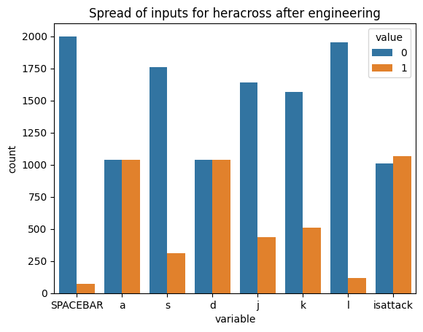
Data Refinement: Putting it together
In addition to bootstrapping and flipping image data, we also implement these data engineering steps:
Randomly dropping a proportion of rows with no attack
Dropping rows with conflicting inputs
Dropping rows with no inputs

Slide 17
Model Refinements
Reducing the learning rate to 1e-6 allowed losses to intercept at higher epochs instead of diverging.
Addition of dropout layer: For each epoch, drop out a randomised proportion of input elements at each linear layer during the forward pass. This is a popular technique for model regularisation.

Slide 18
Conv. layer 1
ReLU activation + pooling
Conv. layer 2
ReLU activation + pooling
Conv. layer 3
ReLU activation + pooling
Batch normalisation layer
Flattening layer
Linear layer 1
ReLU activation + dropout
Linear layer 2
ReLU activation + dropout
Linear layer 3
ReLU activation + dropout
Output layer
Sigmoid activation

Slide 19
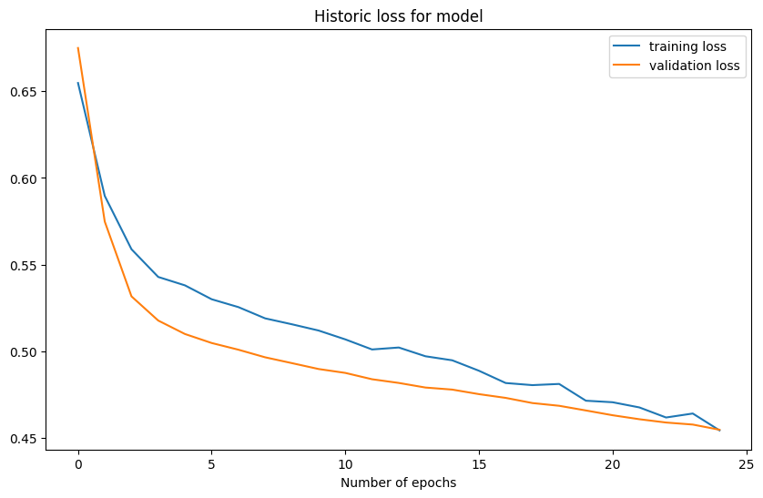
Final model performance
vs Poliwrath
Training loss | 0.454
Validation loss | 0.455
Training Accuracy | 0.787
Validation Accuracy | 0.783

Slide 20
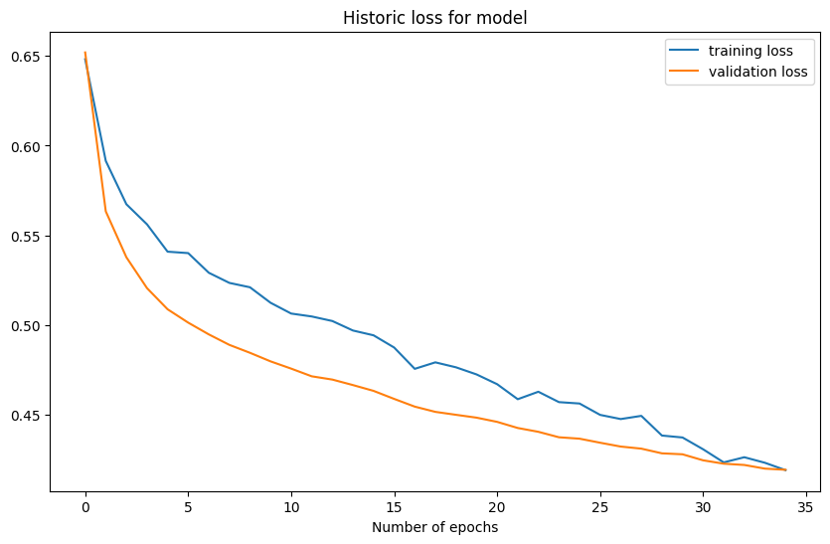
Final model performance
vs Heracross
Training loss | 0.419
Validation loss | 0.419
Training Accuracy | 0.816
Validation Accuracy | 0.818

Slide 21
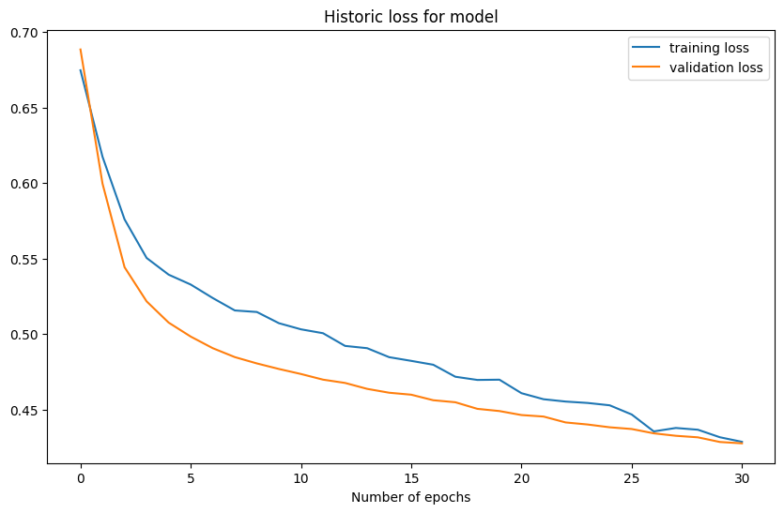
Final model performance
vs Mienshao
Training loss | 0.429
Validation loss | 0.428
Training Accuracy | 0.811
Validation Accuracy | 0.808

Slide 22
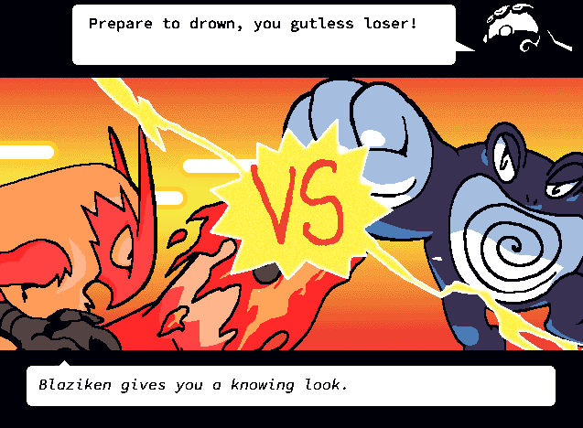
Demo time!

Slide 23

Limitations
Each trained model is huge, almost 900 MB each! It may not be feasible to incorporate these models as they are into a videogame, where multiple different enemy types (requiring different models each) are present.
Lack of data for specific scenarios leads to the model performing poorly in such scenarios.
Bot is unable to perform inputs that require a consecutive sequence of inputs, as it has no concept of historical data.

Slide 24
Future work
To lower the filesize of the model, we can consider reducing the number of convolutional and linear layers, or reducing the dimensions of the input image. This may have adverse effects on the predictive ability of the model but can be explored as an area for improvement.
Combining Long Short-Term Memory (LSTM) models with the CNN model would allow the model to incorporate historical data when performing predictions.

Slide 25
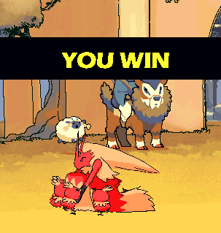
THANK YOU

